Slide 1
This Power Point Presentation
must be viewed in the
“Slide Show” mode for
the animations to function.
Advance the slides by clicking the mouse or the space bar.

Slide 2
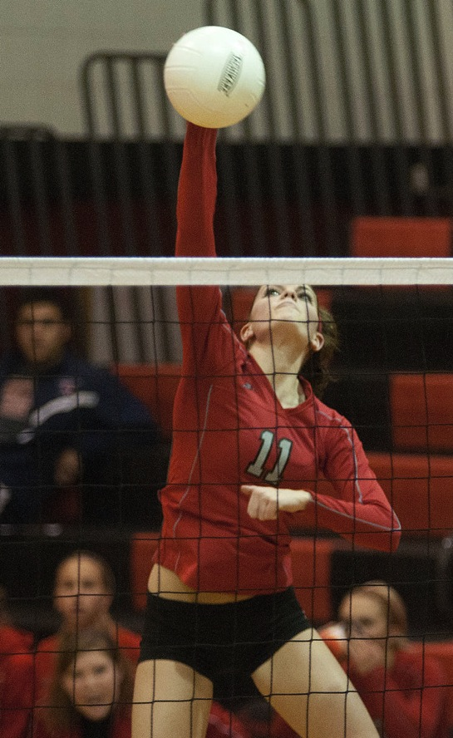
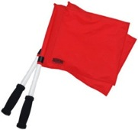

Line Judge Duties and Responsibilities

Slide 3
Overview
Good line judges are essential for a volleyball match.
Competent line judges are trained in their responsibilities and capable of discharging the various duties.
A line judge must be alert and responsive to the leadership and direction of the referees.
All authorized officials shall be secured by the host school.
Line judges shall be provided by the host school.
It is the host school’s responsibility to select, instruct and train line judges.
7. Well in advance of the beginning of the volleyball season, school personnel
should recruit and select line judges (preferably adults) who are willing to
become proficient with this duty.

Slide 4
Overview
(continued)
8. Training should include practiced and theoretical scrimmages and sessions.
9. The line judge must be able to ignore spectator criticism and maintain complete
concentration on the set.
It is not practical or possible for the first referee to instruct and train line judges in
the short time allotted just prior to a match.
11. Time permits only a brief, general review of their duties and responsibilities.
12. As the head official, all final decisions are made by the first referee.
13. The first referee considers the calls made by the line judges.
14. To encourage the line judges to work hard and stay attentive, communication must
take place throughout the match.
15. The first referee may overrule a line judge’s call at any time if he/she determines the
call is incorrect.

Slide 5

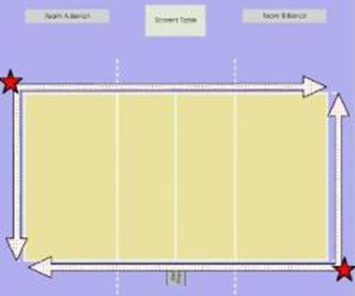
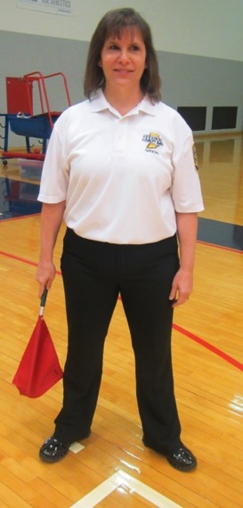
Line Judge Signals
Using Flags
Line Judge Base Position
1. Line judges are assigned their positions by the first referee and shall hold
these same positions relative to the court throughout the match.
2. A line judge’s base position shall be at the intersection of the left sideline and the end line in the LB corner of each court.
Line Judge Positions

Slide 6



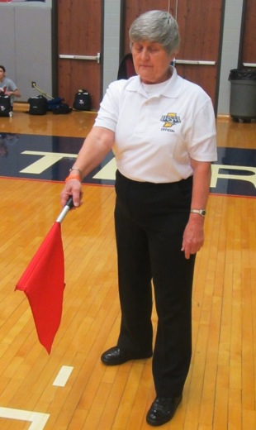
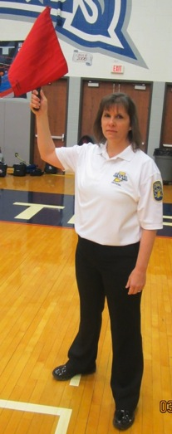

Ball In Bounds
Point with the flag down.
Ball Out of Bounds
Raise the Flag
Line Fault (Foot Fault)
Wave the flag side to side and point with finger to the fault area

Slide 7

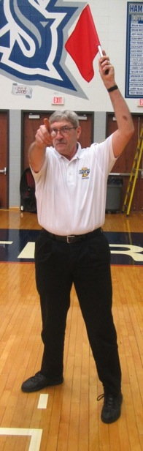
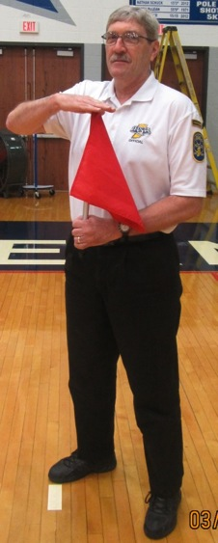
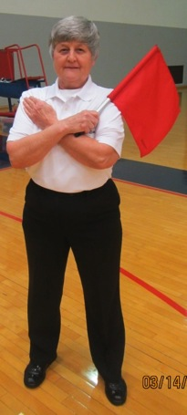
Ball Out of Bounds After
Contact with a Player (Touch)
Raise the flag to shoulder height in front
of the body and place the open palm
of the other hand on the tip of the flag
Antenna Fault
Wave the flag side to side and
point with finger toward the antenna
Did Not See The Play
Cross arms across chest

Slide 8
Recommended Attire for Line Judges
Well in advance of the beginning of the volleyball season, school personnel
should recruit and select line judges (preferably adults) who are willing to
become proficient with this duty.
It is recommended that line judges, as part of the officiating team, wear long pants or slacks.
It is recommended that, in order to show impartiality, line judges not wear any clothing with the school logo of a participating school.
Line judges must wear proper footwear in order to move efficiently during the match. Line judges should not wear loose sandals, flip flops, high heels, etc.
Line judges must not use electronic devices such as cell phones, ipods, etc., while performing their duties.

Slide 9
CHARACTERISTICS
OF A GOOD LINE JUDGE
Reports to the first referee no less than 20 minutes before the scheduled starting time of the match.
Reports promptly to the prematch meeting with the referees. Listens and asks questions to be able to respond to unusual situations
Has previously been properly instructed and trained in all duties and responsibilities.
Performs duties in a confident, quiet, efficient manner. Prepares to perform by moving onto the court and watching lines during the prematch warm-up time.
Is appropriately dressed to indicate they are a part of the officiating team.
6. Is always courteous to the other line judge, referees, coaches and players.

Slide 10
CHARACTERISTICS
OF A GOOD LINE JUDGE
(continued)
Is cooperative and responds in a positive manner to suggestions and directions from the
first or second referee.
Remains detached from coaches, players and spectators before, during and immediately after the match.
Refrains from reacting as a spectator to anything that occurs during the match.
10. Makes objective calls that are both quick and decisive, using the correct signals. Holds
each signal a sufficient time and establishes eye contact with the first referee to allow
for proper communication.
11. Concentrates on duties and responsibilities without being distracted by other people.
12. Is always alert and ready to move quickly into the best position to make a call without
interfering with play. Avoids posture that appears to reflect disinterest.
13. Shows respect for the calls of the other line judge.
14. Shows respect for and accepts, without question, all decisions of the first referee.

Slide 11
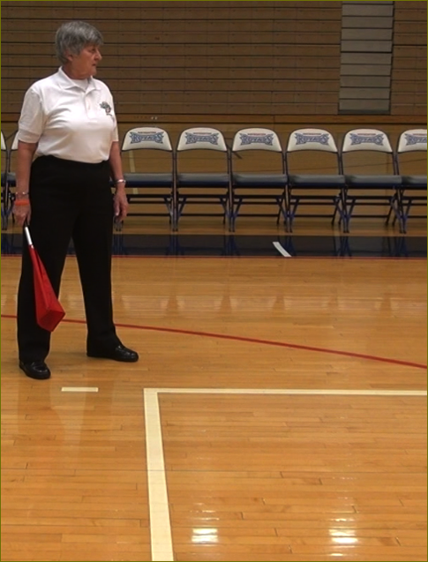
GENERAL GUIDELINES AND RESPONSIBILITIES
Line judges are assigned their positions by the first referee and shall hold these same positions relative to the court throughout the match.
A line judge’s base position shall be at the intersection of the left sideline and the
end line in the LB corner of each court.
(Still Photo)

Slide 12
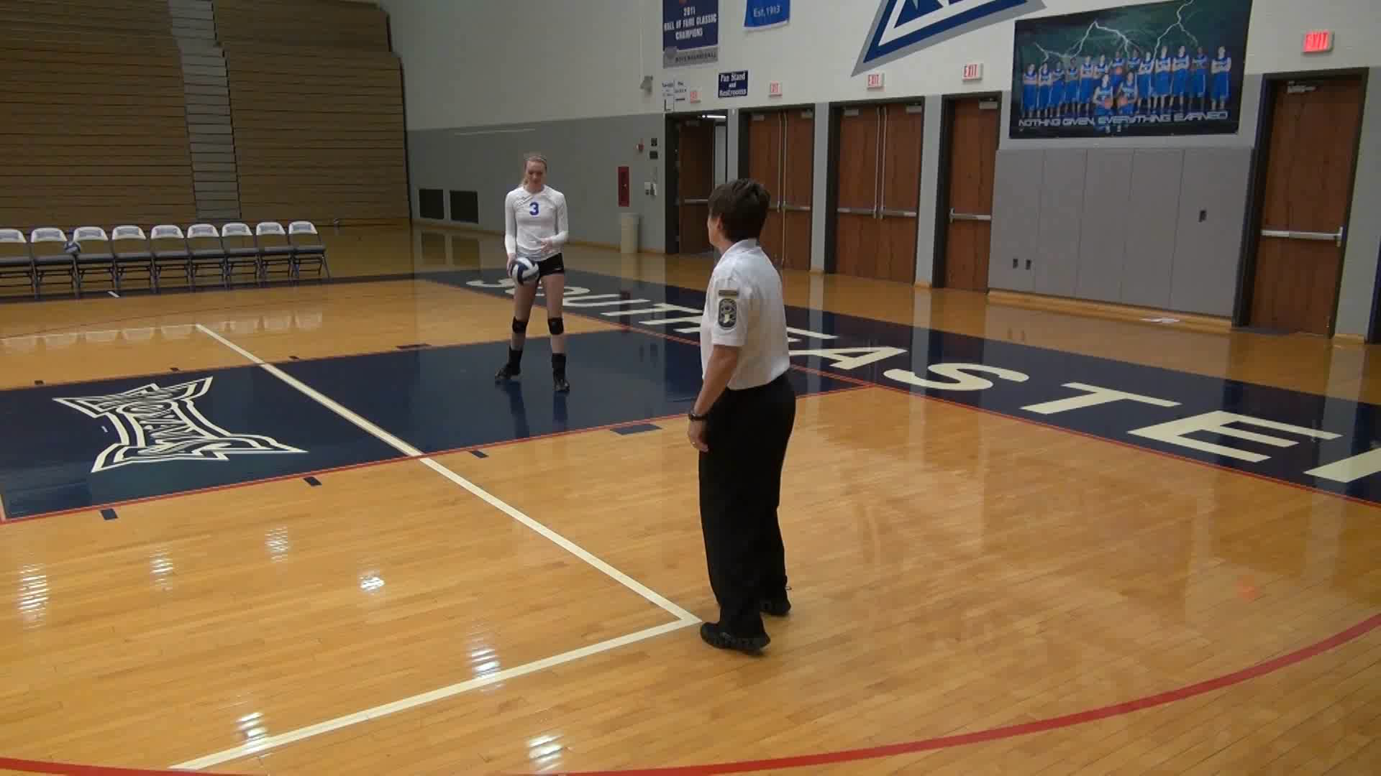

GENERAL GUIDELINES AND RESPONSIBILITIES
3. If the server serves from the left third of the service area and encroaches on the line judge position, the line judge on the serving team’s side shall move a few steps to the side in line with the extension of the end line until the ball is contacted for serve. Then the line judge quickly moves back into position at the intersection of the end line and left sideline.
(Please hover over the video to revel the play button to replay)
Notes:
If the server serves from the left third of the service area, the line judge on the serving team’s side shall move directly back and in line with the extension of the left sideline, out of the peripheral view of the server, until the ball is contacted for serve. The line judge quickly moves back into base position.

Slide 13
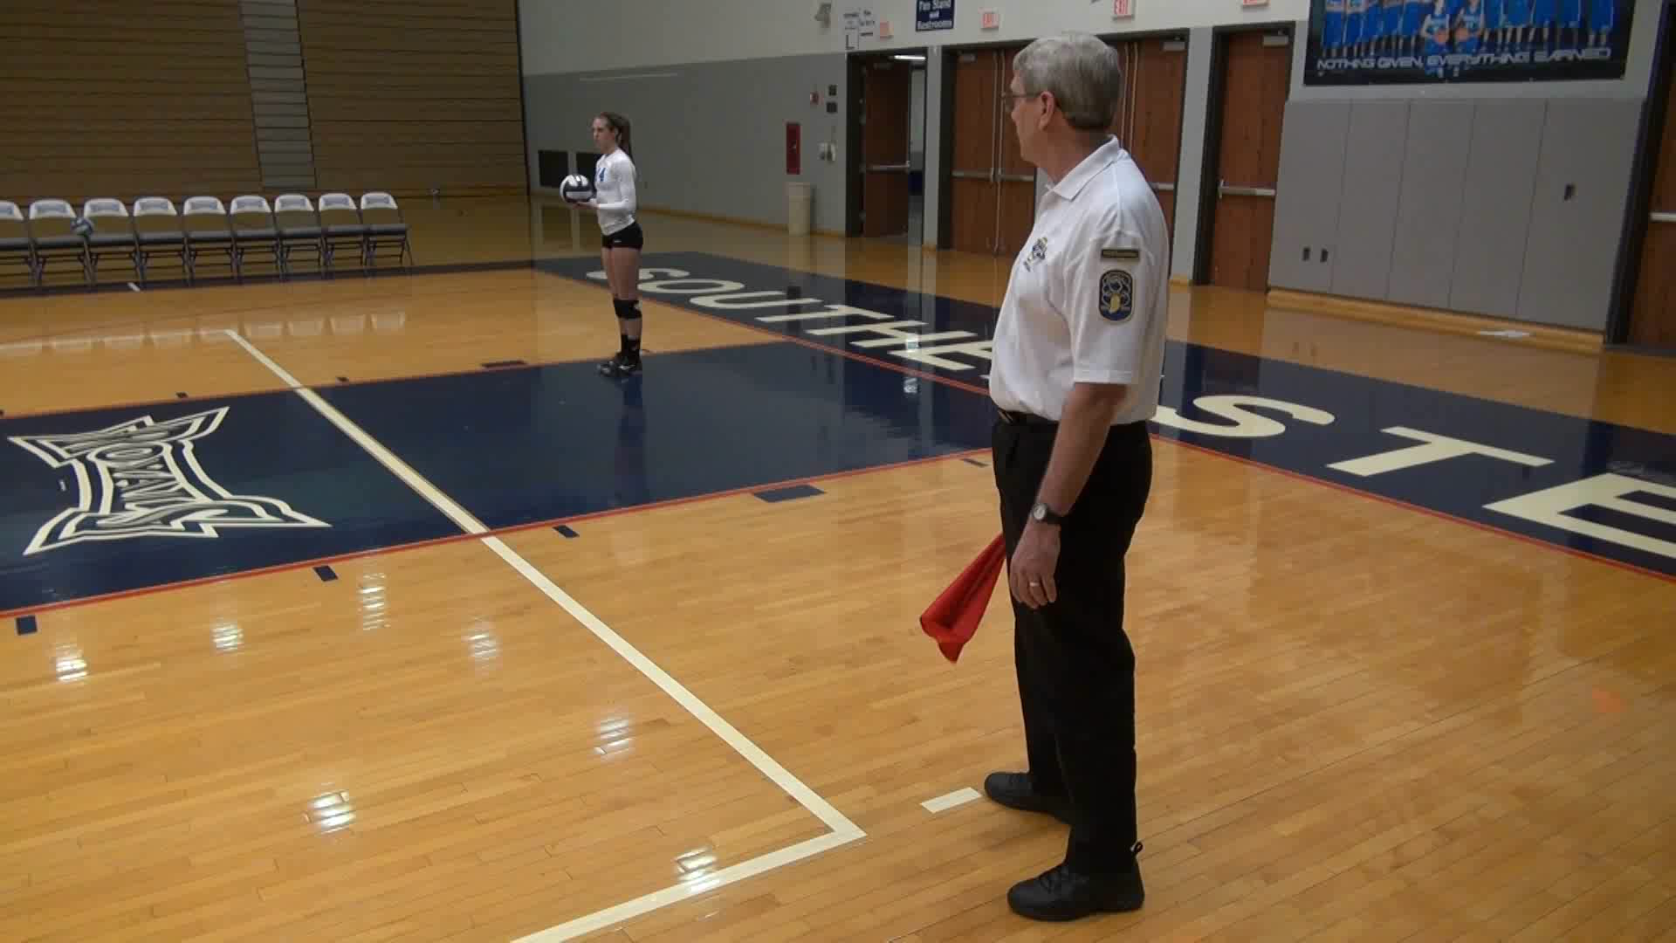
GENERAL GUIDELINES
AND RESPONSIBILITIES
(continued)
Line judges must move to obtain a clear, unobstructed view by facing the entire sideline or end line involved when making an inbounds or out-of-bounds call.
(Please hover over the video to revel the play button to replay)
Notes:
The line judge moves to observe the end line during the serve.
The first video shows the position during a legal serve.
The second video shows a foot fault by the server and the line judge gives the proper signal.

Slide 14
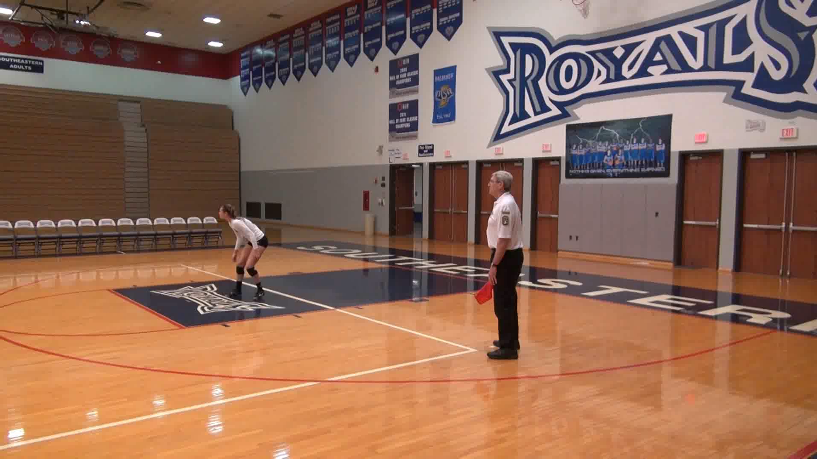
Line judges must be alert to avoid being struck by the ball or interfering with a player’s opportunity to make a play.
(Please hover over the video to revel the play button to replay)
Notes:
Line judges must be alert to avoid being struck by the ball or interfering with a player’s opportunity to make a play while watching the flight of the ball for a possible antenna fault.

Slide 15
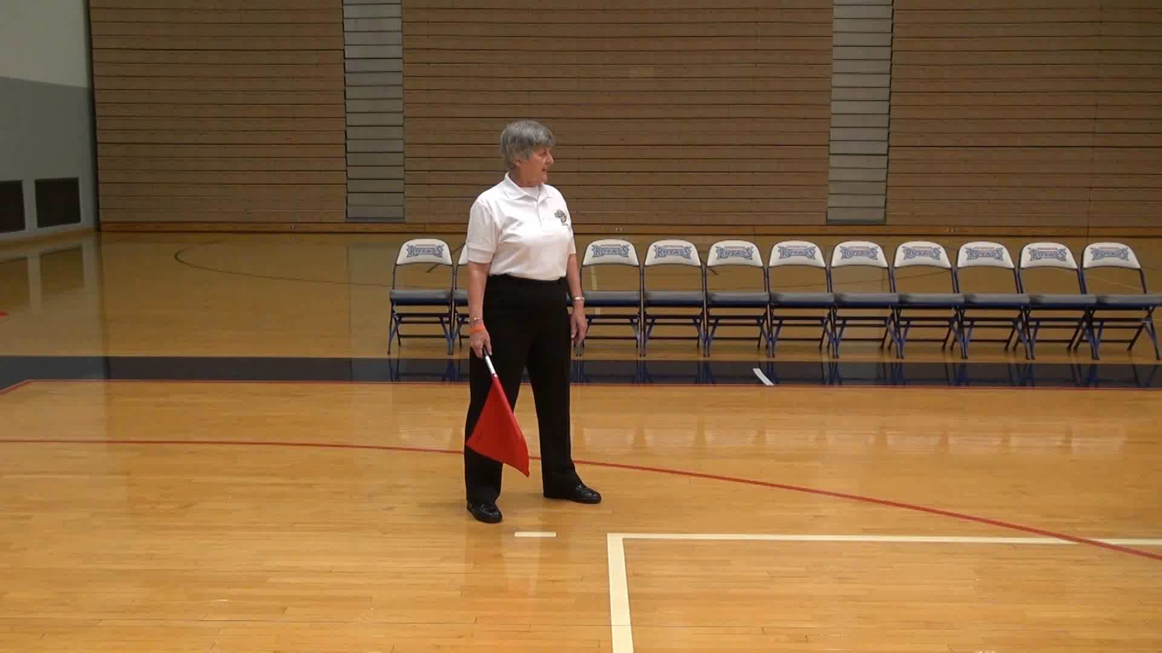
Line judges are to make calls on every play, particularly on or near the sideline and end line closest to them.
A line judge does not need to mirror a fellow line judge’s call.
(Please hover over the video to revel the play button to replay)
Notes:
Line judges are to make calls on every play, particularly
on or near the sideline and end line closest to them.
A line judge does not need to mirror a fellow line judge’s call.

Slide 16
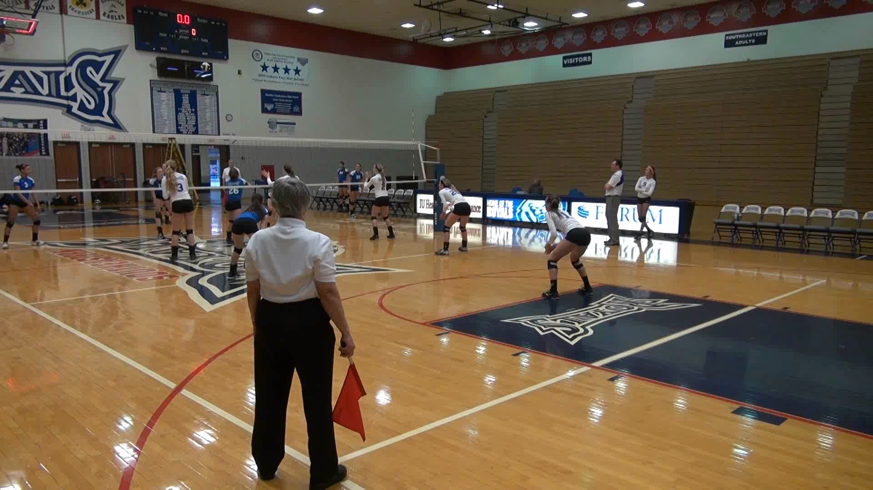
GENERAL GUIDELINES AND RESPONSIBILITIES
(continued)
A line judge may signal a fault on either antenna. Remember which team touched the ball last prior to the antenna fault if referee asks for further clarification.
(Please hover over the video to revel the play button to replay)
9. A line judge may signal a ball contacting the floor (missed pancake) on either court. Even if the ball simultaneously touches the player and the floor, the line judge should give the inbounds signal.
Notes:
A line judge may signal a fault on either antenna. In this video, both line judges signal the ball out of bounds for passing outside the antenna. The line judges must remember which team touched the ball last prior to the antenna fault if referee asks for further clarification.

Slide 17
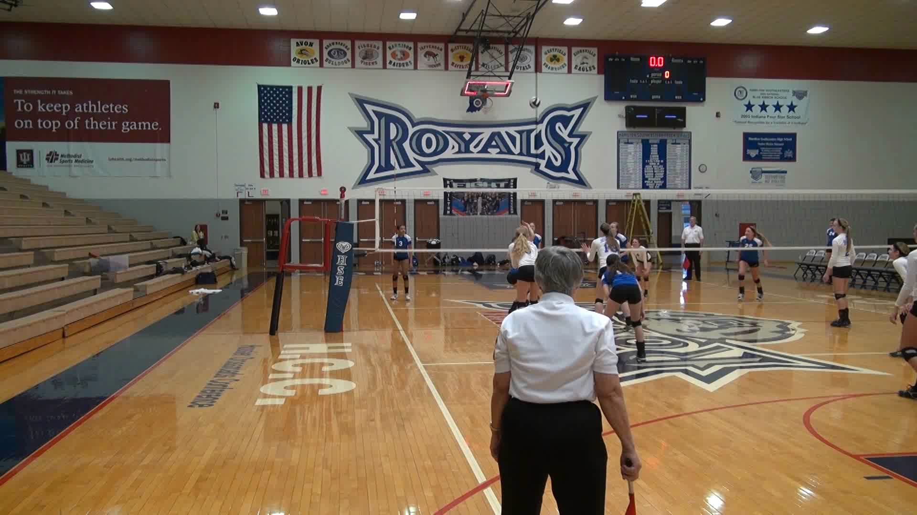
GENERAL GUIDELINES AND RESPONSIBILITIES
(continued)
Line judges shall participate with the referees in the prematch protocol.
Line judges should consider that the net antennas extend up to the ceiling so the ball must cross the net entirely within the net antennas or within the net antennas extended. A ball contacting the antenna within the body of the net is out.
(Please hover over the video to revel the play button to replay)
Notes:
In the first clip the ball contacts the antenna within the net and is signaled out of bounds
In the second clip the ball passes outside the antenna and is signaled out of bounds.

Slide 18
GENERAL GUIDELINES
AND RESPONSIBILITIES
(continued)
Line judges should make their decision quickly and decisively without regard to the call being made by the line judge on the other side of the court.
Line judges must hold their signal until it is seen by the first referee.
Line judges are part of the corps of officials administering the match. They shall not visit with coaches, players or spectators once they have reported to the first referee prior to the match and until the match is over.
Line judges shall report to either referee, on the next dead ball, inappropriate comments made to them by any team member.

Slide 19
SPECIFIC DUTIES
OF LINE JUDGES
Determine at the moment of contact for the serve whether the server touches the end line or the floor outside the lines marking the width of the serving area.
Indicate when the serve, or any played ball, crosses the net not entirely between the net antennas.
Indicate when the ball touches the net, net antenna and/or net supports not entirely between the net antennas. The line judge is in an advantageous position to better judge an antenna violation without giving up position to make a line call.
Indicate whether a ball is in bounds or out of bounds when it lands in any area for which the line judge is responsible. A ball is considered to have landed in bounds if any part of the ball contacts the floor on or within the court boundary lines.
Indicate when a player touches a ball that is going out of bounds on either side of the net. A touch is signaled if a ball goes out of bounds (hits the floor or goes into a nonplayable area) on the same side of the net as the team that last touched the ball.

Slide 20
SPECIFIC DUTIES
OF LINE JUDGES
(continued)
Be prepared to indicate when the ball touches the ceiling or an overhead obstruction when asked by the first referee.
Focus on the line and not the ball when making calls involving lines. Anticipate the line(s) to which the ball is traveling. Focus should then move to that line and wait for the ball.

Slide 21
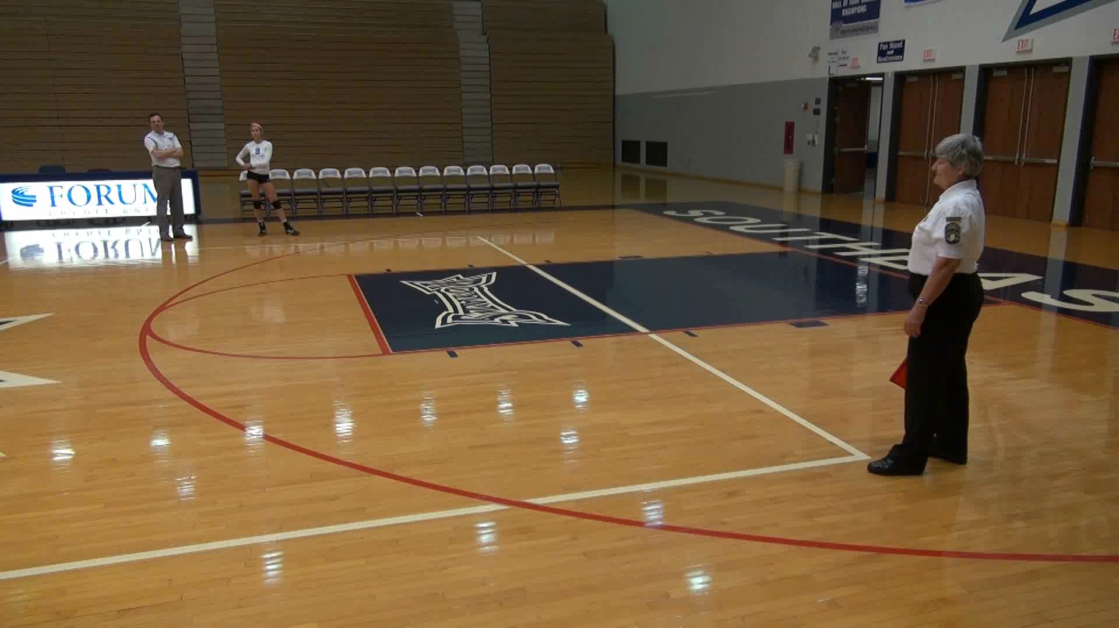
Focus on where the ball actually contacts the line or floor. Learn to look through the players’ legs to see close plays.
(Please hover over the video to revel the play button to replay)
Notes:
In the first clip, the line judge follows the ball to the floor and then signals the ball inbounds.
This mechanic will result in the ball and line being blurred because the eyes cannot
change focus quickly.
In the second clip, the line judge focuses on the line as the ball approaches and signals
the ball inbounds. This is the proper technique to use.

Slide 22
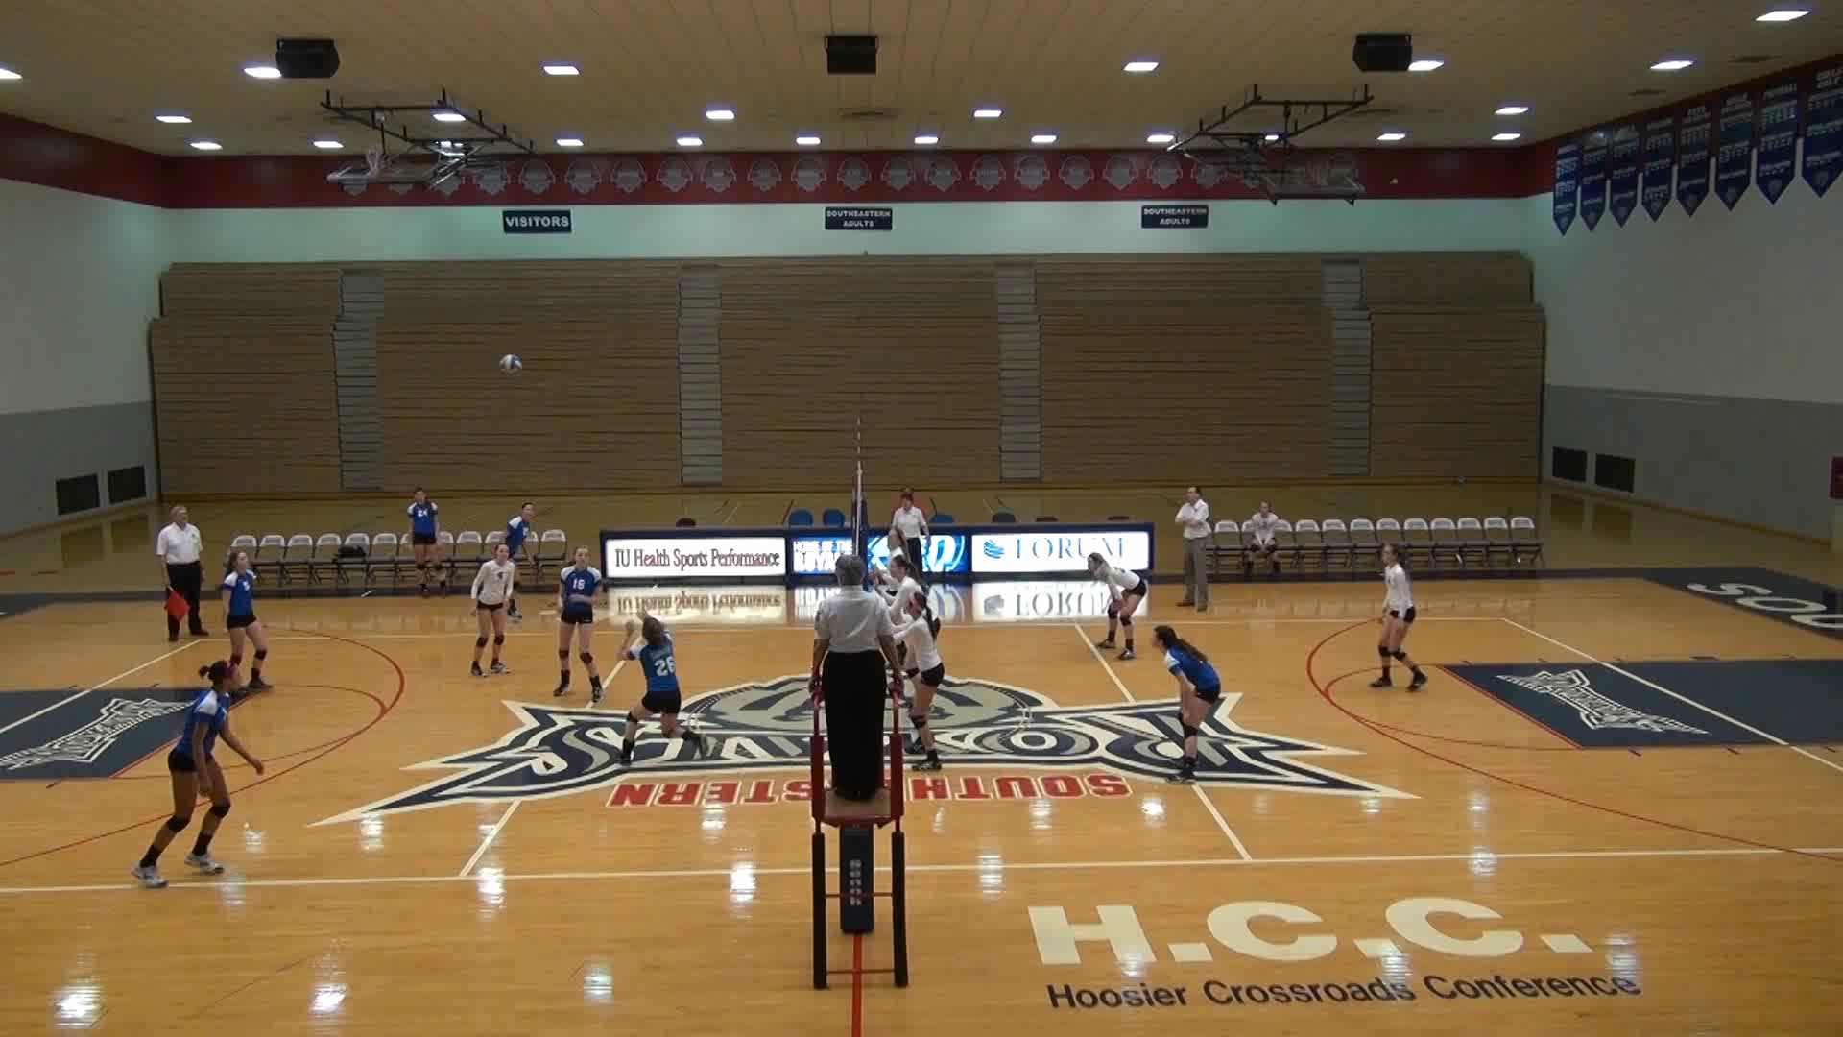
SPECIFIC DUTIES OF LINE JUDGES
(continued)
During a time-out, stand on the respective team’s side of the net, at the intersection of the side line and the attack line, near the first referee and hold the game ball when the team on his/her side of the net is serving. Only approach the first referee’s stand if instructed to do so by the referee or if there is a question.
(Please hover over the video to revel the play button to replay)
Notes:
The blue team scores a point.
The R1 awards the point and signals a touch by the white team. The R2 mirrors the signals.
The R2 whistles and signals a time out called by the blue team and then
indicates the number of time outs used by each team. The R1 mirrors these signals
The line judges move to the attack lines on the R1’s side of the court and remain there during
the time out. The line judges should not converse with the R1 unless the R1 initiates the
conversation.
The line judges return to the assigned corners at the conclusion of the time out. The line judge on the left side court should walk around the court, not across the court.
The R1 awards the point and signals a touch by the white team. The R2 mirrors the signals.
The R2 whistles and signals a time out called by the blue team and then
indicates the number of time outs used by each team. The R1 mirrors these signals
The line judges move to the attack lines on the R1’s side of the court and remain there during
the time out. The line judges should not converse with the R1 unless the R1 initiates the
conversation.
The line judges return to the assigned corners at the conclusion of the time out. The line judge on the left side court should walk around the court, not across the court.
The blue team scores a point.
The R1 awards the point and signals a touch by the white team. The R2 mirrors the signals.
The R2 whistles and signals a time out called by the blue team and then
indicates the number of time outs used by each team. The R1 mirrors these signals
The line judges move to the attack lines on the R1’s side of the court and remain there during
the time out. The line judges should not converse with the R1 unless the R1 initiates the
conversation.
The line judges return to the assigned corners at the conclusion of the time out. The line judge on the left side court should walk around the court, not across the court.

Slide 23
SPECIFIC DUTIES OF LINE JUDGES
(continued)
10. After each set, hold their position until teams have exchanged courts to report to the designated, neutral area.
At the end of each set, assist in retrieving and delivering all game balls to the officials’ table.

Slide 24

WIAA extends a thank you to Indiana High School Athletic Association

