Slide 1
Hosting a Seed Meeting
New AD Zoom Meeting
September 13, 2018

Slide 2
How do I get selected to host a seed meeting?
The WIAA Staff will send an e-mail at the appropriate time of year to request seed meeting hosts. This will vary from sport to sport.
If you are selected, the WIAA staff will notify you.
Seed meeting information is posted on the Sport Homepage under Tournament Information WIAA Girls Volleyball

Slide 3
I was selected to host a meeting, what now?
All seeding meeting materials are located in the Sport-specific homepage, and also in the Tournament regulations for that sport. WIAA Girls Volleyball
Some sports require the host to ask the participating schools to vote on the method (in-person or electronic) of the seed meeting
Once the time/date/location/method of meeting is determined, send that information out to the participating schools

Slide 4
Hosting an in-person meeting
Arrive 1 hour prior to meeting and get set up
Meeting Room with Smartboard/Dry Erase, etc.
Plan on 2 coaches from each school
Provide refreshments if possible
Pens/Pencils/Blank paper for breaking ties
Calculator
Review all seed meeting documents from WIAA website
Computer for entering results onto WIAA Score Center
Copy machine nearby so people can walk out with copies of bracket in hand
Hosting an In-Person Seed Meeting

Slide 5
Hosting an Electronic Meeting
Option 1: 100% via e-mail or Google docs
Option 2: Sharing Season Summaries and voting via e-mail or Google docs and meeting in person for appeals
Hosting a meeting via e-mail
Hosting Seed Meeting via Google
Collecting Season Summaries via Google Docs

Slide 6
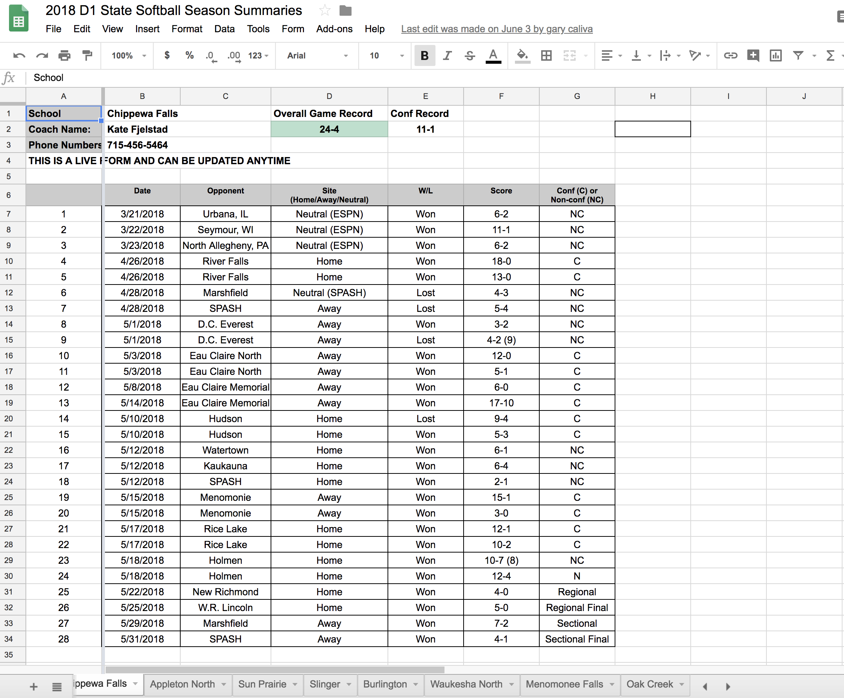
Sharing Season Summaries Via Google Docs

Slide 7
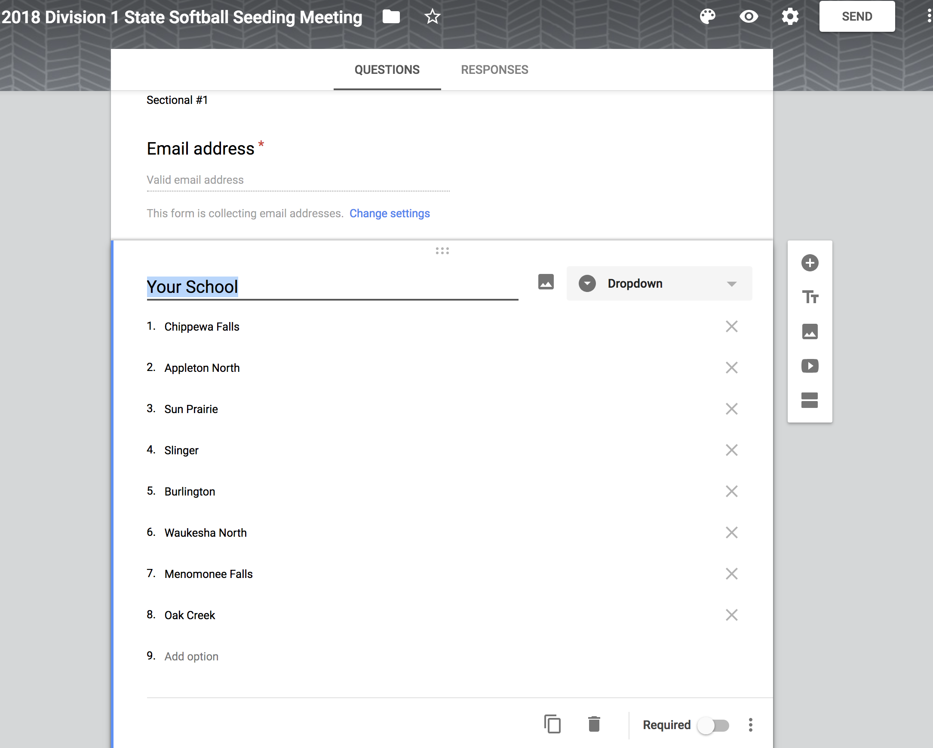
Voting via Google Forms

Slide 8
Ties and Appeals
Review this language prior to the meeting
Call WIAA for clarification in advance or from meeting

Slide 9
Questions?

