Slide 1
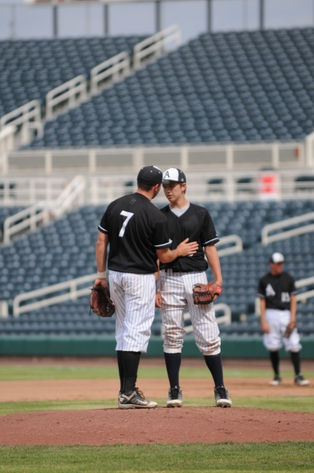
Pitcher’s Arm Care Suggestions
Notes:
The NFHS has been asked by our member state associations to consult with experts in the medical area with suggestions of protecting high school pitchers’ arms. We have identified some of the best in the field of orthopedic and biomechanic medicine. Beginning with input from the NFHS Sports Medicine Advisory Committee and with world renown Dr. James Andrews of Andrews Sports Medicine Institute (ASMI). The following slides represent baseline recommendations for proper caring of a pitcher’s arm. We suggest that coaches and parents consult local orthopedic professionals for additional information and best practices.

Slide 2
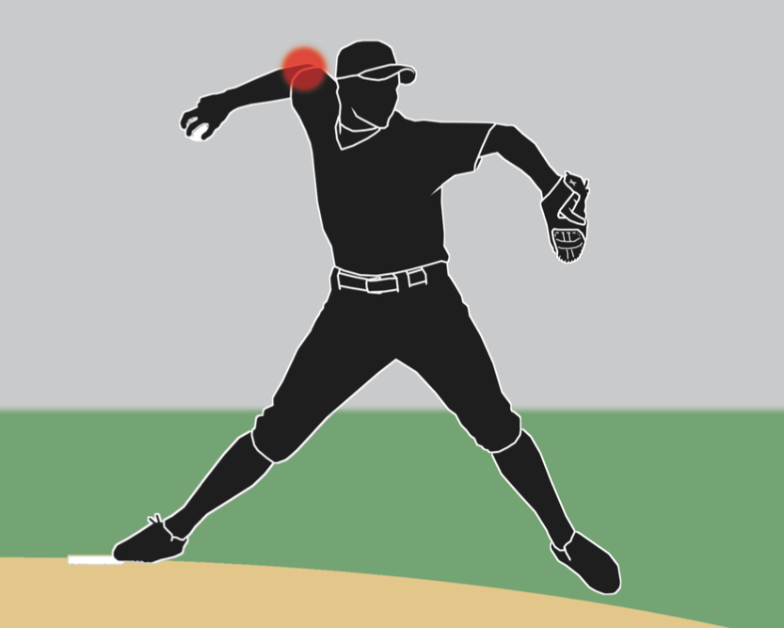
Arm Care
PlayPic®
Coaches have an obligation to take care of their pitchers. Arm injuries continue to rise and proper care must be taken. No single win is worth unnecessary risk or injury to a player.

Slide 3
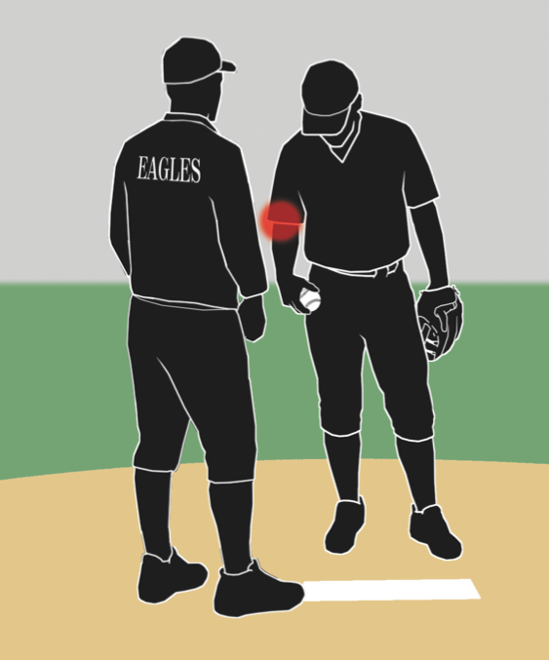
Arm Care
PlayPic®
When a pitcher indicates he is injured, the coach should remove him from the game immediately. His replacement gets as many throws as reasonable to warm up.

Slide 4

Arm Care
PlayPic®
Taking care of a pitcher’s arm following a game is one thing that can be done to help prevent injuries. However, no training or treatment program will prevent all injuries.

Slide 5
Arm Care Suggestions
Arm injuries are on the rise in high school age players.
Most of the arm injuries are at the pitcher position.
45% of pitchers under the age of 12 experience chronic elbow pain.
Ulnar collateral ligament reconstruction (Tommy John) surgeries have increased over 700% in the last decade for adolescent pitchers.

Slide 6
Arm Care Suggestions
4 Main Areas of Concern
Anterior Shoulder
Posterior Shoulder
Medial Elbow
Lateral Elbow

Slide 7
Arm Care Suggestions
Reasons
Overuse, undertrained, inadequate rest, insufficient recovery and repair time
Poor throwing/pitching delivery
Incomplete warm-up and cool down activity
Anatomical limitations or restrictions
Too many games and not enough practices
Poor physical conditioning
Parental and coaching ignorance or worse… indifference

Slide 8
Arm Care Suggestions
Red Flags
Decrease in velocity
Lack of command, breaking ball loses snap
Reluctant to throw off-speed pitches
Pitching delivery changes
Facial grimaces, frustration, rubbing or shaking arm
Normal routine altered, less or more time spent to get ready to pitch
Pain, sensitivity, burning sensation or swelling
Loss of range of motion and/or grip strength

Slide 9
Arm Care Suggestions
Corrective Actions
Proper technical, mental, nutritional and physical training before, during and after pitching with appropriate rest, recovery and repair time
Proper practices, workload management for pitches, pitchers and entire staff
Develop other pitchers to share the pitching load
Observe and understand pitchers’ tendencies, make pain assessments, review past performances, preparation and routine

Slide 10
Arm Care Suggestions
Corrective Actions
No overhead throwing of any kind for at least 2-3 months per year (4 months preferable).
No competitive baseball pitching for at least 4 months per year.
Do not pitch more than 100 innings in games in any calendar year.
Avoid pitching on multiple teams with overlapping seasons.
A pitcher should not also be team’s catcher due to overuse concerns.

Slide 11

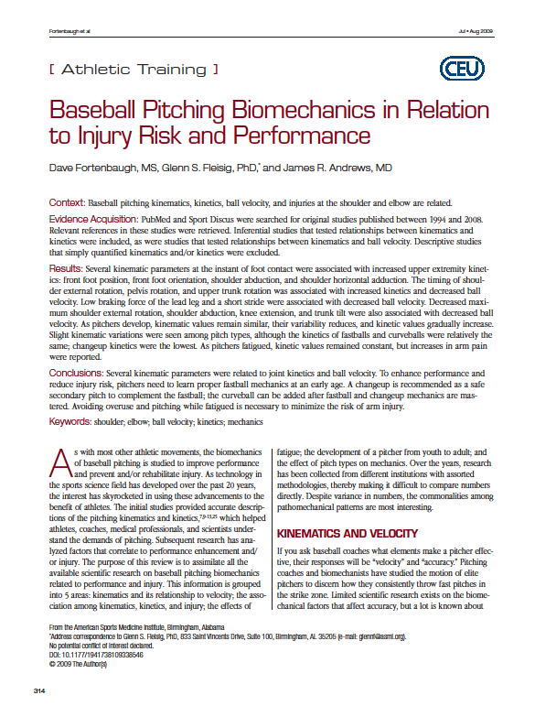
Arm Care Suggestions
PDF References
Notes:
In order to access the relevant medical recommendations for arm care procedures for high school pitchers, double click on any of the three articles saved as a PDF in the PowerPoint.

Slide 12
Arm Care Suggestions
References
The references for these suggestions are from:
Andrews Sports Medicine & Orthopaedic Center – www.andrewscenters.com
Paul Niggebrugge – www.Be Your Best Academy.com
American Sports Medicine Institute – www.asmi.org
  (http://www.asmi.org/research.php?page=research&section=positionStatement)

