Slide 1
Hosting a Seed Meeting
New AD Zoom Meeting

Slide 2
How do I get selected to host a seed meeting for a team sport?
The WIAA Staff will send an email at the appropriate time of year to request seed meeting hosts. This will vary from sport to sport.
If you are selected, the WIAA staff will notify you.
Seed meeting information is posted on the Sport Homepage under Tournament Information. WIAA Girls Volleyball

Slide 3
I was selected to host a meeting, what now?
Read the Seeding Procedure document on the Sport Tournament Page.
Determine how the meeting will be facilitated. (In-person or electronic)
Designate a date, time and location (if applicable) for the meeting. Complete the Seeding Meeting Host Form.

Slide 4
Preparing for a seed meeting
Read the Seeding Procedure document on the Sport Tournament Page.
Instruct all coaches on how to obtain Season Summaries. These can be printed directly from the WIAA ScoreCenter.
*All schools need to be sure their schedules/scores are
updated.
*All schools need to know who is in their seeding
bracket(s) and how to access the Summary Report for
each school from the WIAA Score Center.
Prepare all necessary documents or forms for voting.

Slide 5
What do you need to host a seeding meeting?
Access to the Seeding Procedure document on the Sport Tournament Page.
A way to draw for speaking order (e.g. playing cards, written number cards, online randomization wheel, etc)
A phone or other timing device
A coin
If in-person, extra copies of each schools season summary forms, ranking sheets, brackets, and extra paper for tie-breaking votes, place to display votes, writing utensils
If online, virtual platform (e.g. Zoom or Google Meet) with access for all, online voting form, online tabulation form, online tie-breaking vote option

Slide 6
At the seeding meeting
Follow the procedure on the Seeding Procedure document on the Sport Tournament Page.
Take attendance by having coaches introduce themselves and update their season summary if a recent contest was played.
Draw for speaking order using a predetermined method.
Allow each coach (one per school) to speak for their 3 minute (or less) time; give them a consistent warning(s) prior to the time running out.

Slide 7
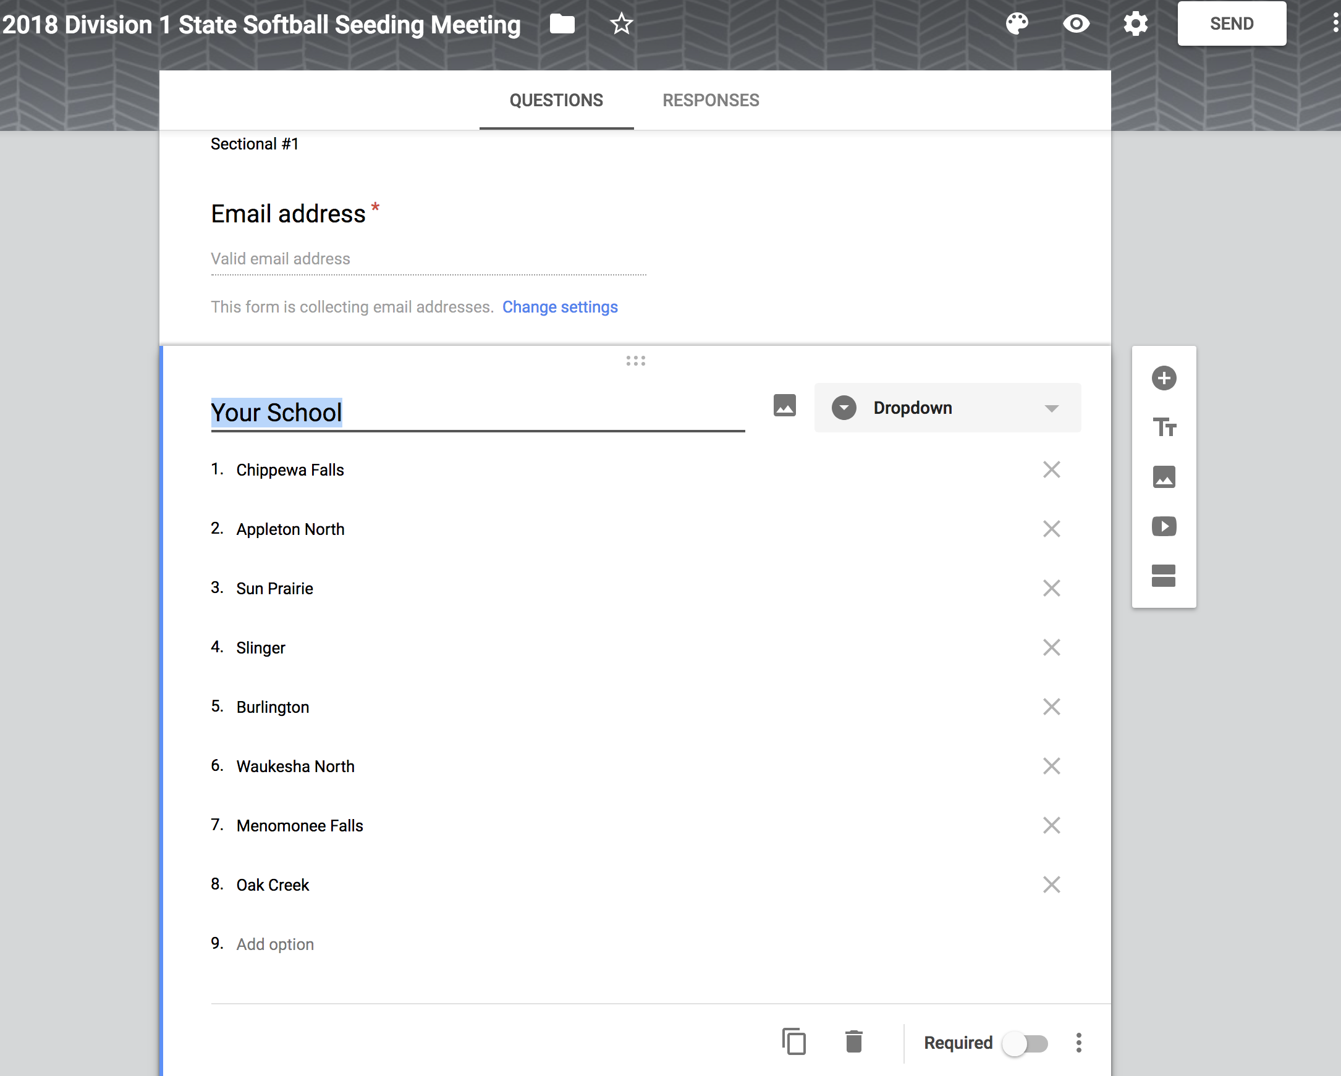
Voting
Within the guidelines of the Seeding Procedure document, coaches vote, or rank, the schools in their bracket. (Coaches do not rank their own team).
Ranking sheets can be created in Google Forms or Docs, sent via email, etc. When in-person they should be completed on the WIAA provided hard copy document.

Slide 8
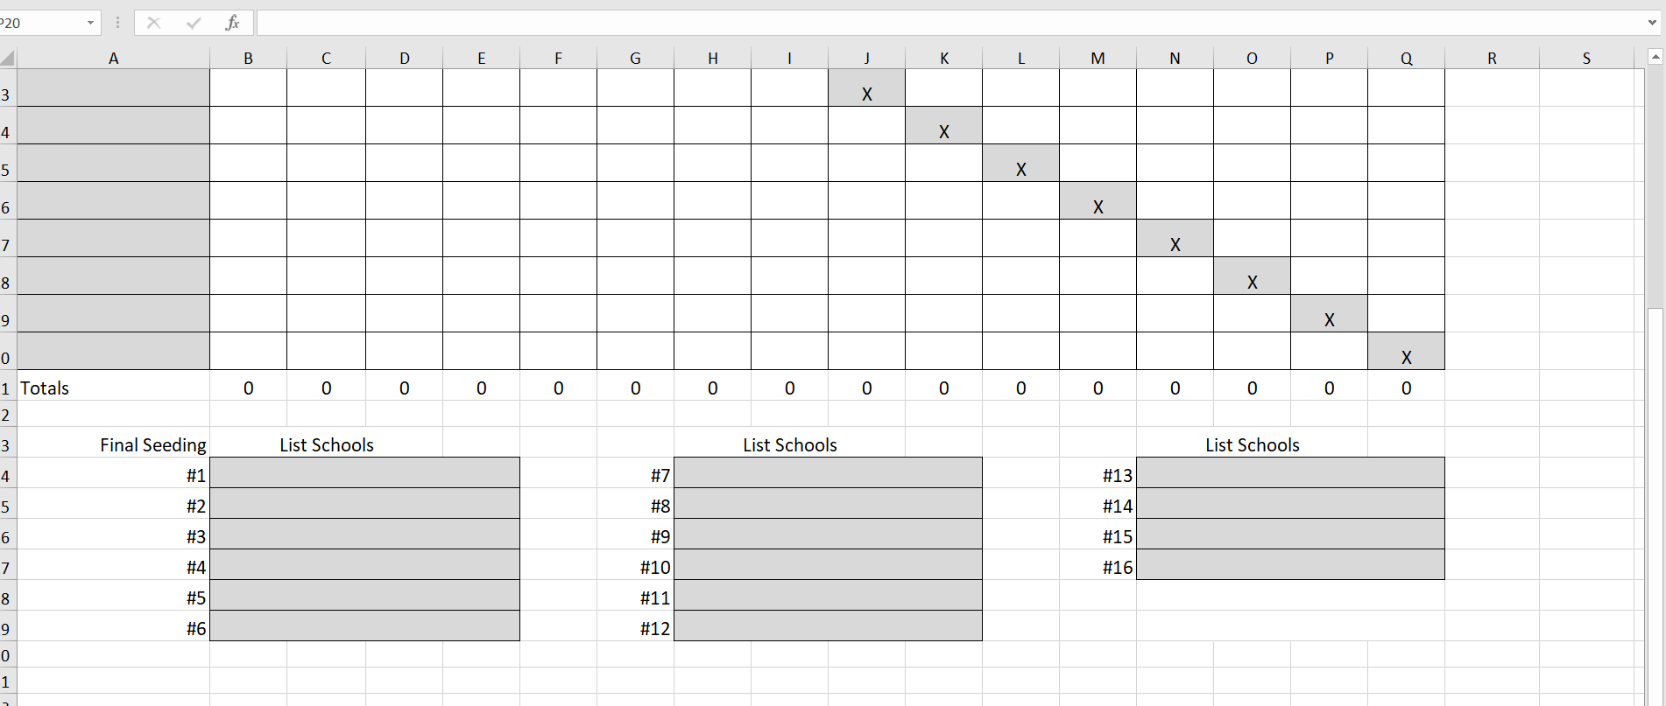
Tabulating and Displaying the Results
There is an Excel file created to tabulate rankings. This, or anything similar, can be used to publicly display the results.

Slide 9
Ties and Appeals
After the Seed Meeting
Follow the Seeding Procedure document for step by step instructions on how to break ties and handle appeals.
Complete the bracket on the link/form provided to you by the WIAA staff. Do not share final seeds with anyone outside the meeting until the bracket is posted in its entirety on the WIAA website.

Slide 10
Questions?

