Slide 1
Editorial Changes
2019 NFHS Softball Rules Interpretation Power Point Slides 21 and 22 addressing Rule 6-1-1 PENALTY EXCEPTION 3 and 4 were revised.
2019 NFHS Softball Case Book
8.4.3 SITUATION N - rule reference 8-4-3d PENALTY (p. 60)
8.4.3 SITUATION O – rule reference 8-4-3e (p. 61)
2019 NFHS Softball Rules By Topic Dead Ball: Illegal Pitch – delete “baserunners are awarded one base” (p. 62) Illegal Position: Penalty – delete “all runners advance one base” (p. 68)
Notes:
This slide lists several editorial corrections –
The 2019 NFHS Softball Rules Interpretation Power Point was recently updated to provide a clarification of information contained on slides 20 and 21. Two 2019 NFHS Softball Case Book edits have been identified. Two correction to the 2019 NFHS Rules By Topic are provided here as well.

Slide 2
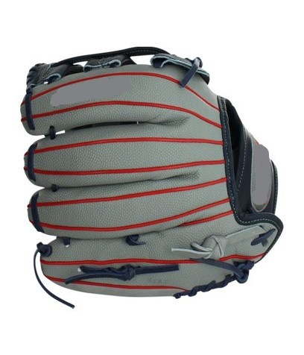
Field and equipment Rule 1-4-1a
ART. 1 . . . Gloves/mitts shall:
a. Be a maximum of two colors
excluding lacing and manufacturer's logo colors. Lacing shall not be the color of the ball.
Clarification: Piping is not considered a part as a color.

