Slide 1
2020-21 NFHS Softball
Substituting, Lineup Management, DP/FLEX, Illegal Substitutes, Courtesy Runners

Slide 2
Rule 3-1-3
Players, Positions
The team's lineup card shall include first initial and last name, jersey number, position and batting order of each starting player and shall include each eligible substitute. Lineups become official after they have been exchanged, verified and then accepted by the plate umpire during the pregame conference.
PENALTY: After the lineup card has been submitted to and verified by the umpire and a change is subsequently made to a player/substitute name or number, or if a player/substitute is added to the lineup card, the umpire shall issue a team warning to the head coach of the team involved. Any further changes made to a player/substitute name or number results in the head coach being restricted to the dugout/bench area for the remainder of the game.

Slide 3
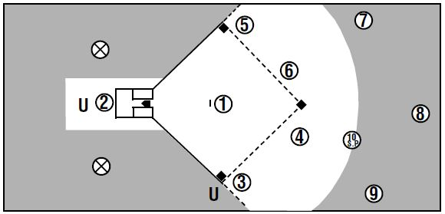
Fielders positions

Slide 4
Rule 3-2-5
Uniforms, Player Equipment
Headwear (caps, visors, headbands, ribbons, etc.) may be mixed. If worn, they must be white, black, beige or school colors (the colors are not required to be the same for team members). The logo may be any color. Flat items, no longer than 2 inches, used to control the hair, such as bobby pins, barrettes and hair clips, are permitted. Plastic visors, bandannas and hair-beads are prohibited.

Slide 5
Rule 3-2-7
Uniforms, Player Equipment
ART. 7 . . . Exposed undergarments, if worn, are considered part of the official uniform. All exposed undergarments shall be a solid single color: black, white, gray or a school color.
a. For individual players, exposed upper-body undergarments do not
have to be the same color as exposed lower-body undergarments.
b. For all team members, exposed upper-body undergarments shall
be the same solid, single color, and all exposed lower-body
undergarments shall be the same solid, single color.
c. Garments other than team uniforms - such as arm sleeves, leg
sleeves, and tights - are permissible. Anything worn on the arm or
leg is a sleeve, except a brace, and shall meet the color restrictions.
EXCEPTION: Any wristband with a playbook/playcard attached shall be considered
equipment and is permitted as long as it is a single, solid color, and it is not optic
yellow. It does not have to match the color of the upper garment. It shall only be worn
on the non-pitching arm.

Slide 6
Rule 3-2-9
Uniforms, Player Equipment
A pitcher shall not wear any item on the pitching hand, wrist, arm or thighs which may, in the umpire's judgment, be distracting to the batter.

Slide 7
Rule 3-2-12
Uniforms, Player Equipment
Players in the game are prohibited from wearing jewelry such as rings, watches, earrings, bracelets, necklaces (including cloth or string types) or other hard cosmetic or decorative items. Religious and medical-alert medals are not considered jewelry. A religious medal must be taped and worn under the uniform. A medical-alert medal must be taped and may be visible. (3-6-1)

Slide 8
Rule 3-3-1
Substituting
A player who is not listed as an eligible substitute on the lineup card shall not be prohibited from playing.
PENALTY: After the lineup card has been submitted to and verified by the umpire and a change is subsequently made to a player/substitute name or number, or if a player/substitute is added to the lineup card, the umpire shall issue a team warning to the head coach of the team involved. Any further changes made to a player/substitute name or number results in the head coach being restricted to the dugout/bench area for the remainder of the game. (3-1-3)

Slide 9
Rule 3-3-2
Substituting
ART. 2 . . . A substitute may replace any player when the ball is dead or time has been called. The substitute or coach shall report to the plate umpire at the time of the change by stating name and shirt number of the:
a. player entering the game for the first time.
b. player re-entering.
c. FLEX who is batting for the DP.
d. DP who is playing defense for the FLEX.
e. player being replaced in the batting order and the position to be occupied in the field if the player is not a courtesy runner.
NOTE: A pitcher may be removed as a pitcher and return as a pitcher only once per inning provided the return does not violate either the substitution or charged conference rule.

Slide 10
Rule 3-3-3
Substituting
The plate umpire shall record all substitutions on the lineup card and then announce immediately any change(s) to the opposing team’s head coach. Projected substitutions are not permitted. If there is no announcement of substitutions, a substitute has entered the game when:
a. a runner takes the place of a runner she has replaced.
b. a pitcher takes her place on the pitcher's plate.
c. a fielder reaches the position usually occupied by the fielder she has replaced.
d. a batter takes her place in the batter's box.
e. and, in each of the above situations, when the ball is declared live by the plate umpire.

Slide 11
Rule 3-3-4, 3-3-5
Substituting
A substitute or courtesy runner shall not enter the contest unreported. (3-6-7, Penalty 8-9-7)
Any player, starter or substitute may be withdrawn from the game and re-entered once, provided such player occupies the same batting position whenever in the lineup. A starter and any substitute for a starter may not be in the game at the same time. A violation results in illegal substitution.

Slide 12
Recording a Sub
Baker
4
Baker is going to bat for Able.
Mark out Baker since she is no longer an available substitute.
Mark out Able since she has left the game.
Write Baker’s name and number in the correct position.

Slide 13
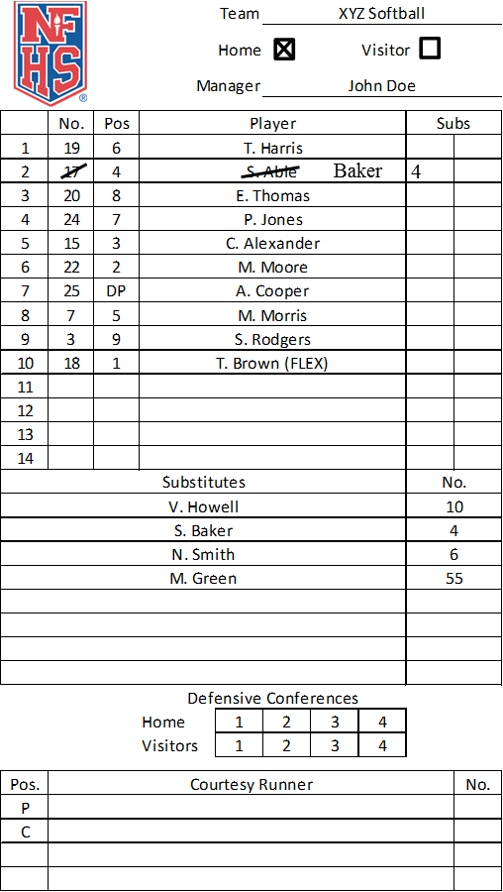
Re-entering a Player
Able is going to play defense for Baker.
Mark out Baker since she is leaving the game.
Circle Able to show she has re-entered the game.

Slide 14
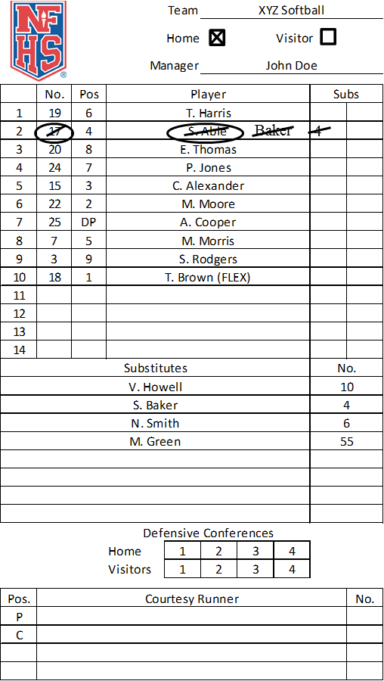
Removing a player a 2nd time
Baker is going to bat for Able.
Diagonally mark out Able to show she has left the game a 2nd time. She cannot re-enter again.
Circle Baker to show she has re-entered the game.

Slide 15
Dp/flex
DP and FLEX split a single player’s responsibilities.
DP is an OFFENSIVE specialist. As long as the DP plays offense (bats and runs) she has not left the game.
FLEX is a DEFENSIVE specialist. As long as the FLEX plays defense (any position on the field) she has not left the game, and she MUST have a defensive position listed in the starting lineup.

Slide 16
Beginning the game
A DP does not have to be used.
If used, it must be noted on the starting lineup. (3-3-6)
A team using the DP starts the game with 10 but could end with 9 or 10 players. (3-3-6d(1), 3-3-6f(1))

Slide 17
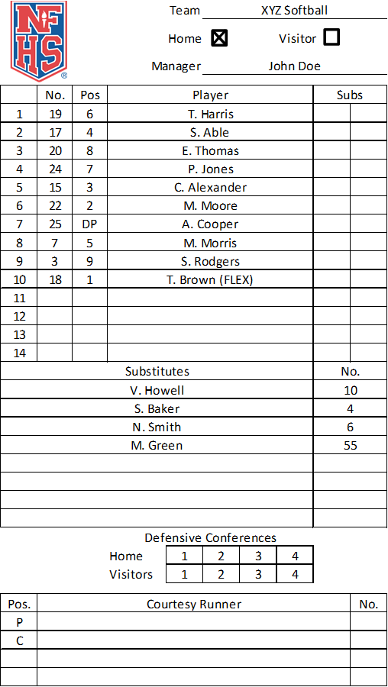
The Lineup Card
The DP is the offensive player and must remain in same batting position (one of top 9 spots) for the entire game. (3-3-6a,c)
The name of the player for whom the DP is batting (FLEX) will be placed in 10th position in the lineup. (3-3-6b)

Slide 18
substituting
If replaced by a substitute, the DP position remains in the lineup.
(3-3-6d)
A starting DP may re-enter one time, as long as the DP returns to the original position in the batting order. (3-3-6d)

Slide 19
Substituting for the dp
The DP may be replaced by:
  Pinch-hitter
  Pinch-runner
  FLEX
In all cases, the DP has left the game (is not playing offense anymore), with one re-entry permitted.

Slide 20
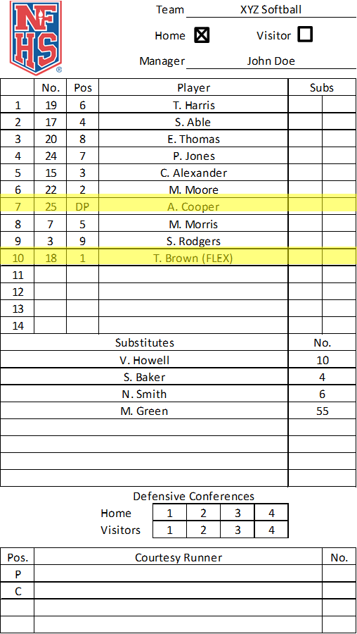
Substituting For The DP
Baker pinch-runs for Cooper.
Baker
4
Cooper has left the game and may re-enter once.
Baker is now the DP.

Slide 21
The Flex May Play Offense
If the FLEX bats or runs for the DP, the DP has left the game.
The FLEX (Brown) is now batting in the 7th position.
The lineup is now down to 9 players.
Notes:
Any player may re-enter once.

Slide 22
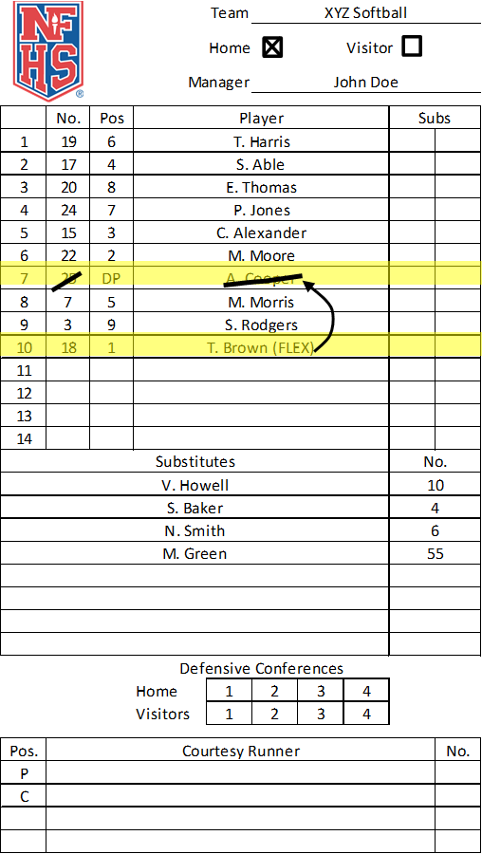
The DP Re-Enters
The DP (Cooper) re-enters to bat or run.
The FLEX (Brown) returns to #10 position playing defense only.
The FLEX has never left the game.

Slide 23
The dp may play defense
The DP may also play defense at any position. (3-3-6e)
If the DP plays defense for a player other than the FLEX, that player still bats and has not left the game. (3-3-6e)

Slide 24
The DP May Play Defense
Able no longer plays defense but still bats 2nd.
4
Cooper plays second base and still bats 7th.
Able has not left the game, and Cooper is still the DP

Slide 25
The DP May Play
Defense For The Flex
Cooper goes in to pitch.
1
Brown has left the game.
The lineup is now down to 9 players.
Brown may re-enter once.

Slide 26
Scenario #1
At Plate Conference after lineups are official, Coach A says “My DP is going to play defense for my FLEX”.
Next ½ inning coach A says “My FLEX is going to bat for my DP”.
Next ½ inning Coach A says “My DP is going to play defense for my FLEX”.
What is each players status at this point?

Slide 27
Stepping through scenario #1
“My DP is going to play defense for my FLEX”.
  At this point FLEX has left the game, DP’s status has not changed.
“My FLEX is going to bat for my DP”.
  FLEX has used their one re-entry, DP has now left the game.
“My DP is going to play defense for my FLEX”
  DP has used their one re-entry, FLEX has left the game for the second time-they are done for the game (player not position).

Slide 28
Scenario #2
At Plate Conference after lineups are official, Coach A says “My FLEX is going to bat for my DP”.
After the FLEX gets on base Coach A says “My DP is going to run for the FLEX”.
Next inning Coach A says “My FLEX is going to bat for my DP”.
What is each players status at this point?

Slide 29
Stepping through scenario #2
“My FLEX is going to bat for my DP”.
  At this point DP has left the game, FLEX’s status has not changed.
“My DP is going to run for the FLEX”.
  DP has used their one re-entry, FLEX’s status still has not changed.
“My FLEX is going to bat for my DP”.
  FLEX still hasn’t changed their status, DP has left the game for the second time-they are done for the game (player not position).

Slide 30
Illegal substitution
You CANNOT:
Place the FLEX player into the first nine positions somewhere other than the original DP’s position.
This would result in an illegal substitution. (3-3-6g)

Slide 31
Key points
The role of the DP/FLEX is never terminated.
A team may go from 10 to 9 players and back to 10 players any number of times during the game, as long as the substitution rules are followed.
The game may end with 10 or 9 players.

Slide 32
Easy reminders
The DP CAN NEVER be on defense only.
The FLEX player CAN NEVER be on offense only.
The DP and the FLEX CAN NEVER be on offense at the same time.
The DP and the FLEX CAN play defense at the same time.

Slide 33
Rule 3-3-8
If a team is playing with 9 (F.P.), 10 (S.P. or F. P. if DP/FLEX is used), or 11 (S.P. if an EP is used) and there are no available substitutes when a runner advancing on an awarded base or after reaching base is unable to continue:
  The previous batter not on base is allowed to replace that player as a temporary runner until she is put out, scores or the half-inning ends.
  When the player who could not continue is scheduled to bat, an out shall be called.
  When the half-inning ends and the team assumes a defensive position. (4-3-1g)
  Once a team has gone short-handed and another eligible player is available, that player may fill the empty space in the lineup.

Slide 34
Rule 3-3-9
Any player who exhibits signs, symptoms, or behaviors consistent with a concussion (such as loss of consciousness, headache, dizziness, confusion, or balance problems) shall be immediately removed from the game and shall not return to play until cleared by an appropriate health-care professional.
See NFHS Suggested Guidelines for Management of Concussion in Appendix B.

Slide 35
Rule 3-3-10
A coach or athlete who is bleeding, has an open wound, has any amount of blood on the uniform, or has blood on his/her person, shall be directed to leave the game until the bleeding is stopped, the wound is covered, the uniform and/or body is appropriately cleaned, and/or the uniform is changed before returning to competition. If medical care or treatment can be administered in a reasonable amount of time, the individual does not have to leave the game. The length of time that is considered reasonable is umpire judgment. The re-entry rule would apply to players taken out of the game for this rule..
See Communicable Disease Procedures, Appendix D.

Slide 36
Rule 3-4-1
Illegal offensive or defensive players may be discovered by the umpire or either team anytime after the ball becomes live and an illegal substitute has taken a position as:
  a. a runner she has replaced or as a batter in the batter's box;
  b. a pitcher on the pitcher's plate, or as a fielder reaching a position
  usually occupied by the fielder being replaced; or
  c. a courtesy runner if that player has violated the courtesy runner
  rule.
PENALTY: Restricted to the dugout/bench area for the remainder of the game. (3-4-1a, c) She is also called out.

Slide 37
Rule 3-4-2
Illegal offensive players may be discovered:
  a. when in the batter's box, the ball is live and/or before the batter- runner reaches first base, or is put out and before a pitch is delivered to the next batter of either team;
  when the illegal batter-runner or runner advances, scores or causes a play to be made that allows another runner(s) to advance or score, and the infraction is detected before the next pitch by either team;
  c. when an illegal batter-runner or runner advances, scores or causes a
  play to be made that allows another runner(s) to advance or score,
  and the infraction is detected after the next pitch by either team;

Slide 38
Rule 3-4-2
  d. in a game-ending play prior to all infielders and/or umpires leaving the diamond.
  PENALTY: The illegal substitute is restricted to the bench/dugout for the remainder of the game. (3-4-2a, b) She is called out. (3-4-2c, d) If still on base, she is called out. (3-4-2a) The proper batter is considered to have lost her turn at bat. The next proper batter shall bat. (3-4-2b, d) Play is nullified. Outs made on play stand. Runners not put out return to base(s) occupied at the time of the pitch. (3-4-22c) Play stands.
  NOTE: The penalty for illegal substitution takes precedence over the batting-out-of-order penalty.

Slide 39
Rule 3-4-3
Illegal defensive player is discovered before the next pitch to either team when:
    a. involved in a play with batted ball;
    b. a non-batted ball is handled or touched by an illegal
    substitute that leads to a runner being put out;
    c. a non-batted ball is handled or touched by an illegal
    substitute that alters the play, but no runner is put out
    (i.e., on an overthrow on a stealing runner, the illegal
    substitute retrieves ball and prevents runner from
    advancing farther).

Slide 40
Rule 3-4-3 penalties
1. The illegal player/substitute shall be restricted to the dugout/bench for the remainder of the game. (3-4-3a, b) Team on offense has option of taking the play or accepting the penalty (out is nullified, runners return to base occupied at time of pitch.) (3-4-3c) Umpire may award bases based on his/her judgment and the circumstances concerning the play. (3-4-3a) The batter is allowed to bat again with the same count. (3-4-3b, c) The pitch is canceled if it is a strike or stands if it is a ball.
2. After another pitch, all play stands but the illegal player/substitute is still restricted to the dugout/bench for the remainder of the game.
3. Any time a non-batted ball is handled or touched by an illegal substitute and does not lead to a runner being put out or alter a play, the play stands and the illegal substitute is restricted to the dugout/bench.

Slide 41
Rule 3-5-3
Any time a coach is in live-ball area to confer with players or an umpire, or to occupy a coach's box, the coach shall be attired in school uniform or jersey/coaching shirt with coaching shorts/slacks or warm-up suits (including fleece warm-ups) in school colors or colors of khaki, black, white or gray. Cutoffs or any type of jeans are prohibited. Jackets are not considered part of the coach's uniform.
PENALTY: A coach not dressed in appropriate attire shall not be permitted in the field of play following the pregame conference for the duration of the game or until the situation has been remedied.

Slide 42
Rule 3-5-4, 3-5-5
A coach shall not physically assist a runner during playing action.
PENALTY: (Art. 4) The runner is out and the ball is in play. (8-6-5)
Offensive team personnel, other than the base coach, shall not be near a base to which a runner is advancing or returning; nor shall anyone fail to vacate any area (including a coach's box) needed by a fielder in an attempt to put out a batter or runner. (8-6-16)
PENALTY: (Art. 5) The ball is dead. The runner closest to home is out and all runners not out must return to the last base touched at the time of the interference.

Slide 43
Rule 3-6-6
Only the batter, runner(s), on-deck batter, coaches in the coach’s box, bat/ball shaggers or one of the nine players on defense (S.P. 10) are permitted to be outside the designated dugout/bench or designated warm-up areas. (3-5-7)
NOTE: Bench personnel are permitted to engage in throwing and running activities during the one minute designated for the pitcher to throw her five warm-up pitches at the beginning of each half inning.

Slide 44
Rule 3-6-17
Team personnel shall not intentionally remove any lines of the batter’s box or on the field of play.
PENALTY: A strike shall be called on the batter if a member of the offense intentionally removes the line and a ball awarded to the batter if a member of the defense intentionally erases a line. A team warning shall be issued, with the next offense resulting in a strike/ball, the offender and the head coach being restricted to the dugout.

Slide 45
Rule 3-7-1
Each team, when on defense, may be granted not more than three charged conferences without penalty during a seven-inning game to permit coaches or their representatives to confer with a defensive player or players. In any extra-inning game, each team shall be permitted one charged conference without penalty each inning while on defense. The number of charged conferences permitted is not cumulative. A request for time for a conference may be made by a coach, player, substitute or bench personnel. Time granted for an obviously incapacitated player shall not constitute a charged conference. A conference is not charged when the pitcher is removed as pitcher. This defensive team charged conference rule coverage is effective when the ball first becomes live at the start of each half-inning.
NOTE: If the incoming pitcher has already pitched in the game, she will receive five warmup pitches. When a pitcher is removed by rule and the incoming pitcher has not pitched in the game, the umpire is authorized to permit additional warm-up pitches.
PENALTY: After three charged conferences in a seven-inning game, or for any charged conference in excess of one in each extra inning, the pitcher shall be removed as pitcher for the duration of the game.

Slide 46
Rule 3-7-2
Each team, when on offense, may be granted not more than one charged conference per inning to permit the coach or any of that team's personnel to confer with base runners, the batter, the on-deck batter or other offensive team personnel. The umpire shall deny any subsequent offensive team requests for charged conferences. This offensive team charged conference rule coverage is effective when the ball first becomes live at the start of each half inning. Time granted for an obviously incapacitated player shall not constitute a charged conference.

Slide 47
Rule 3-7-3
When either team has a charged conference, the other team may also have a conference which is not charged, provided the non-charged conference concludes when the opposing team's charged conference concludes, thus not delaying the game.

Slide 48
Rule 8-9-1, 8-9-2
The team at bat may use a courtesy runner for the pitcher and/or the catcher at any time. Neither the pitcher nor the catcher will be required to leave the game under such circumstances. The same courtesy runner may not run for both the pitcher and the catcher any time during the game.
2. In the top of the first inning only, the pitcher and catcher are identified as those
players listed on the lineup as the pitcher and catcher; both must face at least the
first batter on defense (one pitch). Thereafter, the pitcher and catcher are identified
as the last players who physically played that position on defense. The pitcher or
catcher must bat and reach base legally (or earn their way on base) in order to be
eligible for a courtesy runner.
EXCEPTION: When an injury or disqualification occurs in the top of the first inning to the pitcher/catcher identified on the lineup card and she is unable to face the first batter in the bottom of the first inning, the player who ran for her is retroactively her substitute, no longer a courtesy runner. All substitution rules apply and the pitcher/catcher has left the game.

Slide 49
Rule 8-9-3, 8-9-4
Players who are currently in the game or have participated in the game in any other playing capacity are ineligible to serve as courtesy runners.
A player may not be a substitute for any player in the half inning that she ran as a courtesy runner.
EXCEPTION: When an injury or disqualification occurs and no substitutes are available, the courtesy runner must be used as a substitute, and take the place of the injured player. Should the courtesy runner be on base, and is entered as a substitute, the pitcher or catcher for whom the courtesy runner is running, must run in her place.

Slide 50
Rule 8-9-5, 8-9-6
5. The courtesy runner is not permitted to run as a courtesy runner for the Designated Player (DP),
if the DP is only batting, and not playing defense, for the pitcher or the catcher.
Once the courtesy runner is designated for that half-inning, the pitcher or catcher for whom she is running may not return to run while that courtesy runner is on base. A courtesy runner shall not run for a courtesy runner. When a legal substitute replaces a courtesy runner, the player for whom she was running has left the game.
Exceptions:
1. Should an injury or disqualification occur to any other offensive player, and no substitutes are
available, the courtesy runner must take the place of the player. In this case, the courtesy runner
enters as a substitute and the pitcher or catcher for whom the courtesy runner is running, must
run in her place.
2. When the courtesy runner is injured or disqualified, the player for whom she is running (pitcher or
catcher) may return to run the bases or a legal substitute may be entered.

Slide 51
Rule 8-9-7 and penalties
Penalty: (Art. 1-6) illegal substitute. (3-4)
CR must be reported to plate umpire.
Penalty: (Art. 7) Unreported substitute. (3-3-4, 3-6-7)

Slide 52
Cr scenario #1
In the top of the third inning B8, the DP, singles to left field, Coach A asks for time and wants the FLEX (the pitcher) to run for DP. Is this legal? Yes, the DP has left the game and has 1 re-entry.
After two pitches to B9, Coach A asks for time and wants to enter #12, an unused sub, as a CR for the pitcher. Is this legal? No, the pitcher must have earned their way on base to be eligible for a CR. The FLEX was substituted for after the DP was on base so they did not earn their way on base.

Slide 53
Cr scenario #2
In the top of the first inning B2, the catcher singles to left field, Coach A asks for time and enters #8 an unused sub as a courtesy runner. Is this legal? Yes
In the top of the 8th inning B3 is due up to bat and B2, the catcher, is to be placed on 2B to start the inning; Coach A wants to use #8 for the catcher as a CR. Is this legal? Yes, the catcher earned their way on base by their position in the lineup and the tiebreaker rule placing them on base.

Slide 54

Thank You
National Federation of State High School Associations
PO Box 690 | Indianapolis, IN 46206
Phone: 317-972-6900 | Fax: 317.822.5700
www.nfhs.org | www.nfhslearn.com | www.nfhsnetwork.com

